Slide 1


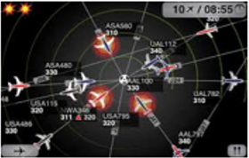












NIEMOpen
Military Operations (MilOps)
Sub-Committee
NIEMOpen is a community-driven standards development initiative producing multiple specifications that are voluntary consensus standards as defined in the OMB Circular A-119, and in compliance with the open-standard mandate in section 12(d) of Public Law 104-113.
MilOps is one of 18 NIEM sub-committees.
The MilOps sub-committee captures and catalogs DoD-specific exchanges, as defined by mission managers and supporting reference model, while providing the governance and framework necessary to develop those exchanges.
Problem Statement: DoD lacks the ability to manage enterprise-level data; impacting interoperability and Globally Integrated Operations.
Purpose: The MilOps sub-committee ("MilOps") provides and maintains unique military operations and mission data components used to define NIEM Message Exchange Packages (MEPs) that satisfies mission critical information sharing requirements within DoD, and/or Federal government agencies, and Mission Partners.
MilOps works towards the alignment of data standards within DoD, aimed at improving the visibility, understandability, accessibility, trust, and interoperability of shared data. MilOps is continuing the development of information exchange tools as a reusable resource within DoD.
Benefits of NIEM/NIEMOpen
Key Enabler of CJADC2
Common Vocabulary
Reduced Maintenance Costs
Lower Development Costs
Enhanced Mission Capabilities
"Track" vs "Track"
Vs.
DoDI 8320.07

Slide 2

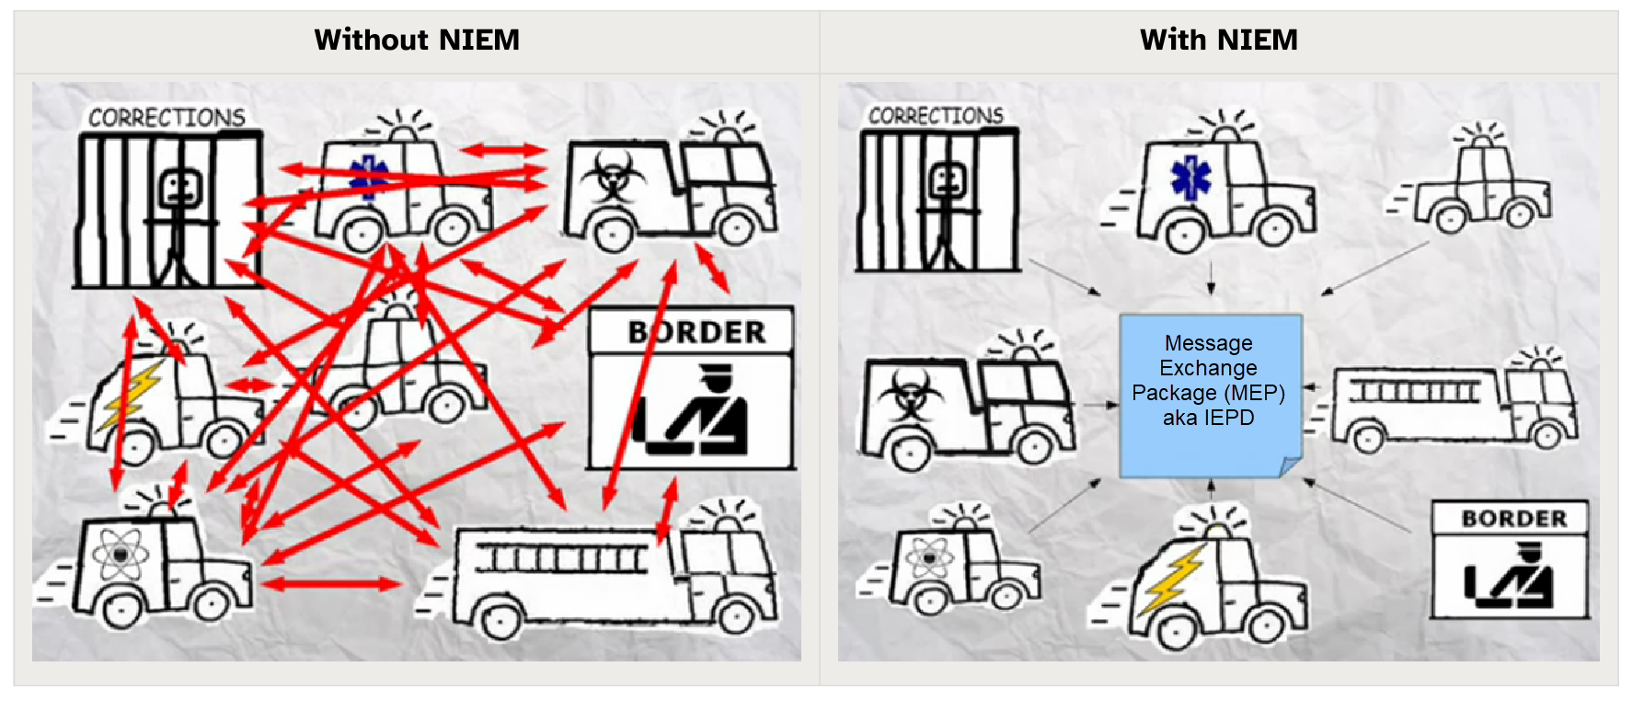






NIEMOpen Military Operations (MilOps)
Sub-Committee
Implementations
CJADC2
MILSTD 6070 USMTF
MILSTD 6016 Link 16
MILSTD 6017 VMF
WMA Portal
Air Force STITCHES (Drone)
Army UC2 4.0
DISA Electromagnetic Spectrum (EMS)
Amber Alert
ANSI 42.42
NATO Core Data Framework (NCDF)
DMBOK
Resources
Free NIEMOpen Training
Leverage NIEMOpen MilOps SMEs
Become a Member of MilOps
https://wmaafip.js.mil/NIEM/Index
MEP repository
Contact
Email: js.dsc.j6.mbx.milops@mail.mil
Tel: 757.203.9670
DoD Joint Staff, J-6
Co-Chair: Ms. Beth Smalley
Co-Chair: Mrs. Darcy Staley
Secretariat: Mr. Nicholas Ballard
https://www.linkedin.com/groups/1903175/
https://www.milsuite.mil/wiki/NIEMOpen_Military_Operations_Sub-Committee
https://x.com/niemconnects
https://niemopen.org/
https://www.niem.gov/communities/military-operations/

